Slide 1

Who’s Afraid of SAR?
Abraxas3d@DEFCON32

Slide 2
Synthetic Aperture Radar
Achieves finer resolution.
A radar where the antenna moves and the target is stationary.
A radar where multiple static antennas measure a moving target.
A combination!

Slide 3
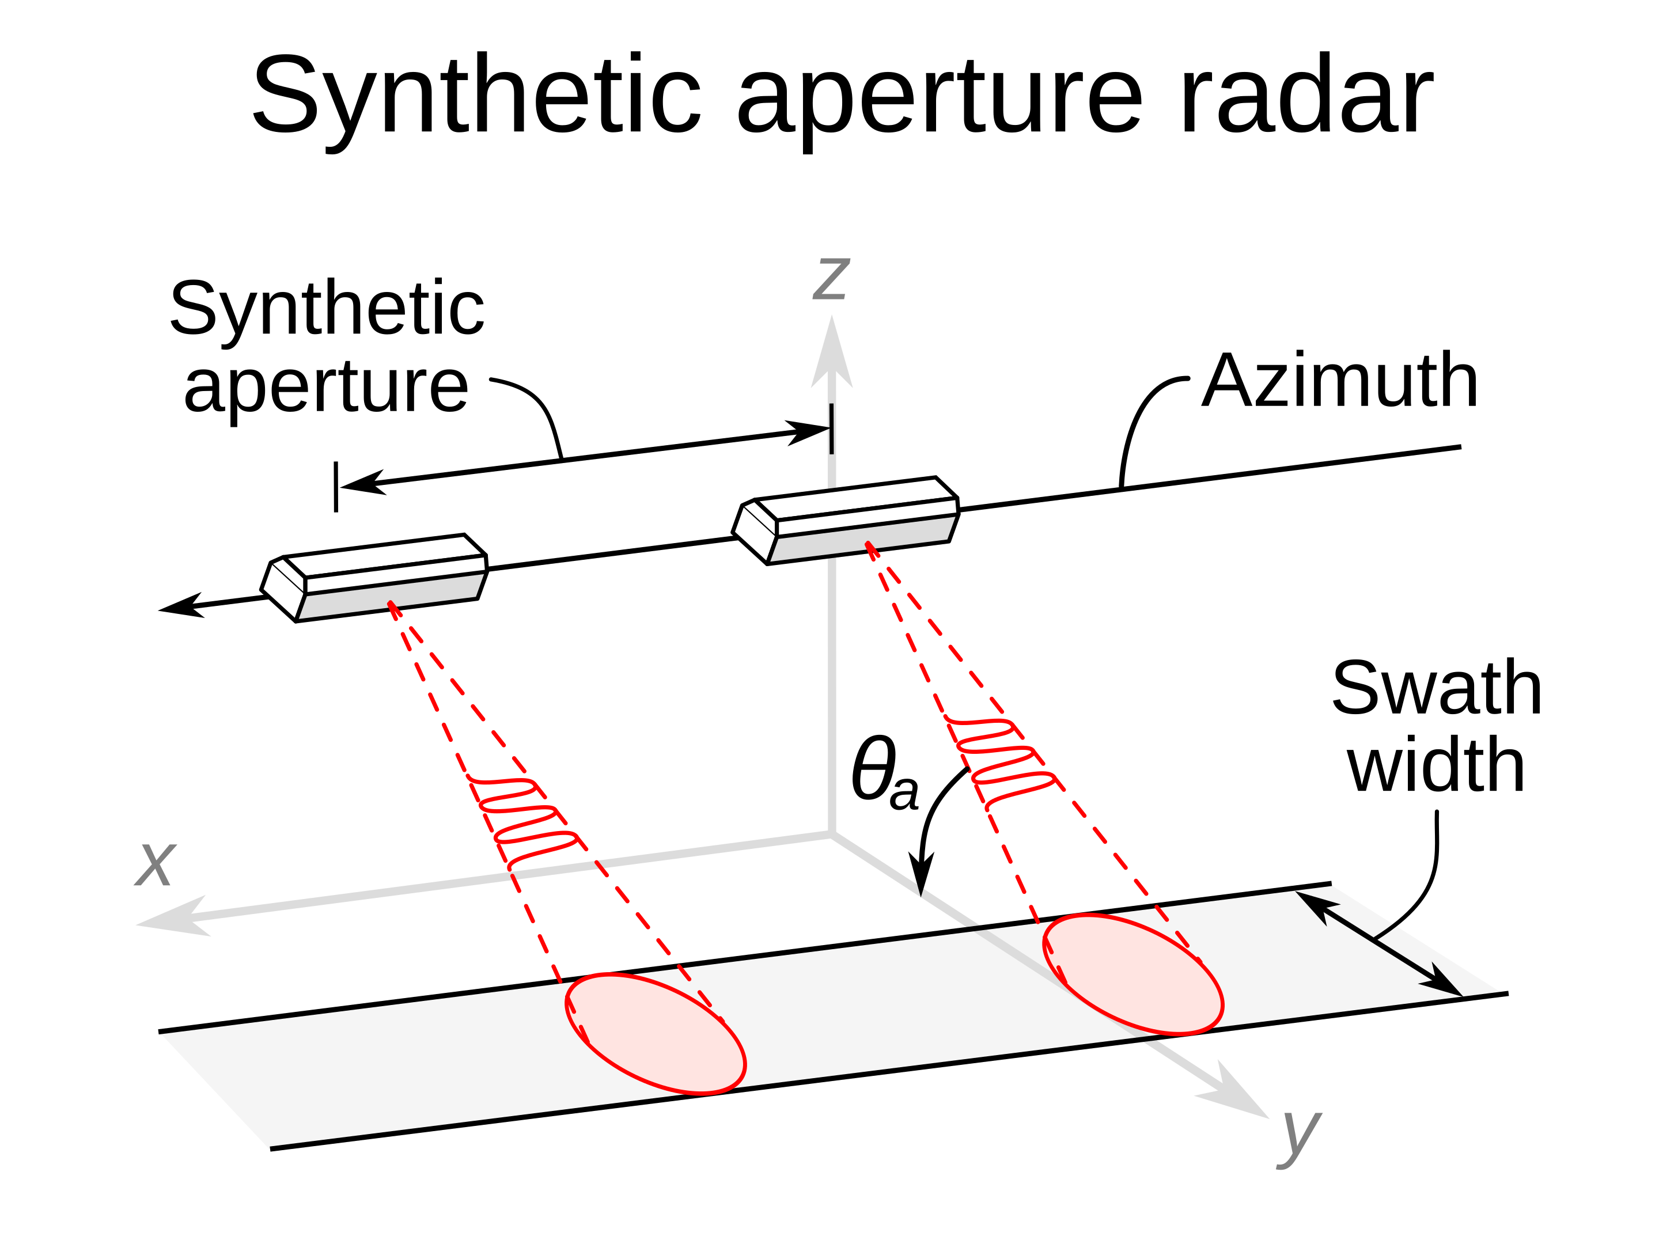
By RCraig09 - Own work, CC BY-SA 4.0, https://commons.wikimedia.org/w/index.php?curid=89538257

Slide 4
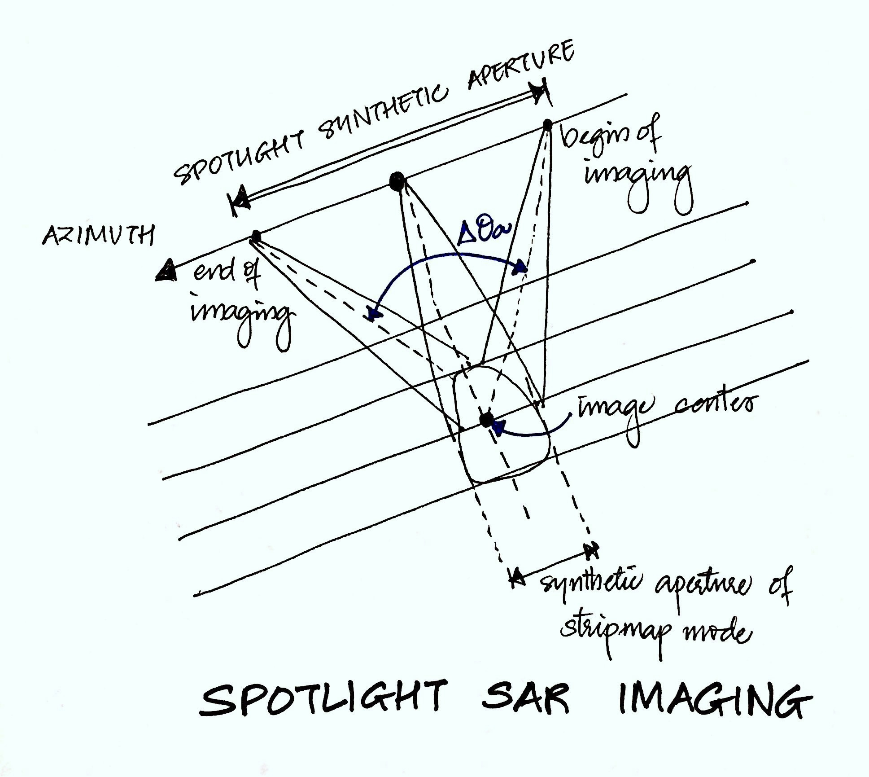
Satellite flies by, takes multiple images, we find the center of each of these images, we process the stack of images.
By Apoorvams - Own work, CC BY-SA 4.0, https://commons.wikimedia.org/w/index.php?curid=53170590

Slide 5
Constant Time vs. Constant Angle
Constant Time
Required to efficiently mathematically process digitally sampled data, such as sampling voltages induced in an antenna by man-made electromagnetic radiation.
Constant Angle
Synthetic aperture radar can be more efficiently processed by sampling at constant angle intervals, rather than constant time intervals.

Slide 6
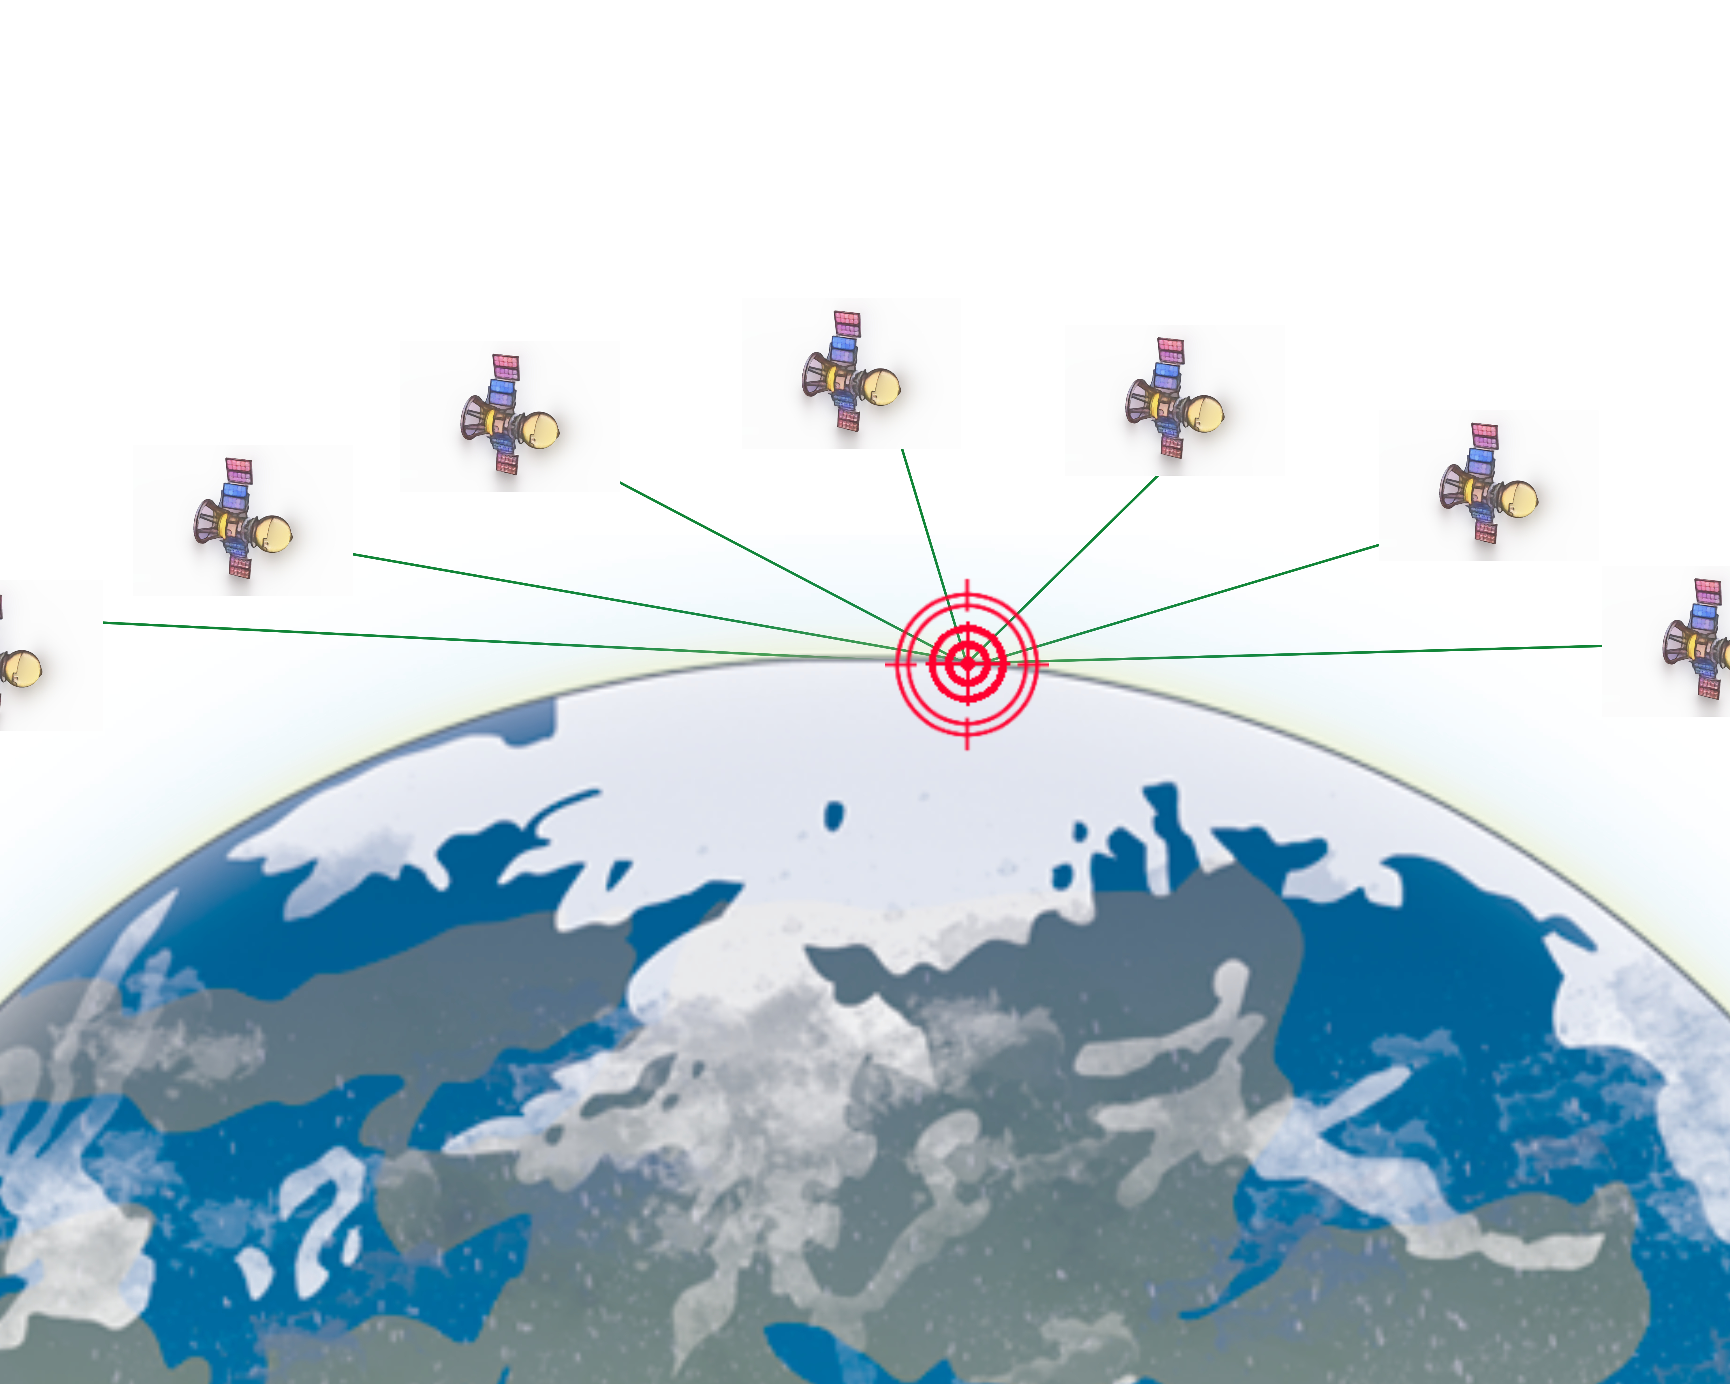

Slide 7
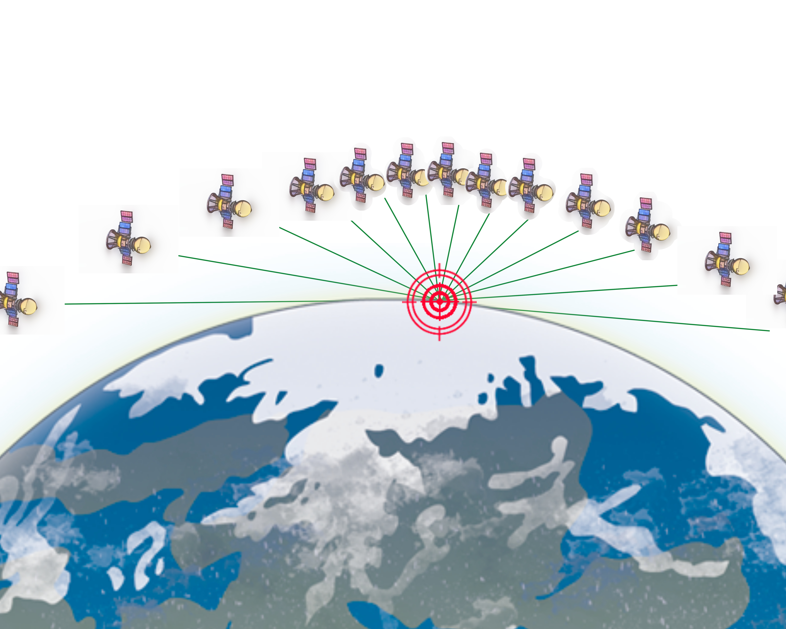

Slide 8

Significant Historical Examples
Seasat NASA/JPL (1978)
Magellan NASA (1989)
Spaceborne Imaging Radar Space Shuttle NASA (1994)
AIRSAR NASA/JPL (1998)
Lincoln Labs LIMIT (2014)

Slide 9
Learn How: MIT Open Courseware
https://ocw.mit.edu/courses/res-ll-003-build-a-small-radar-system-capable-of-sensing-range-doppler-and-synthetic-aperture-radar-imaging-january-iap-2011/
Build A Small Radar System Capable Of Sensing Range, Doppler, And Synthetic Aperture Radar Imaging “Coffee Can Radar”

Slide 10
So What’s the Problem?
Title 22 Chapter I Subchapter M Part 121 Category XI—Military Electronics (a)(3)
(ii) Synthetic Aperture Radar (SAR) incorporating image resolution less than (better than) 0.3 m, or incorporating Coherent Change Detection (CCD) with geo-registration accuracy less than (better than) 0.3 m, not including concealed object detection equipment operating in the frequency range from 30 GHz to 3,000 GHz and having a spatial resolution of 0.1 milliradians up to and including 1 milliradians at a standoff distance of 100 m;
(iii) Inverse Synthetic Aperture Radar (ISAR);

Slide 11
So What’s the Problem? (Part 121 is also known as The United States Munitions List)
Title 22 Chapter I Subchapter M Part 121 Category XI—Military Electronics (a)(3)
(ii) Synthetic Aperture Radar (SAR) incorporating image resolution less than (better than) 0.3 m, or incorporating Coherent Change Detection (CCD) with geo-registration accuracy less than (better than) 0.3 m, not including concealed object detection equipment operating in the frequency range from 30 GHz to 3,000 GHz and having a spatial resolution of 0.1 milliradians up to and including 1 milliradians at a standoff distance of 100 m;
(iii) Inverse Synthetic Aperture Radar (ISAR);

Slide 12
United States Munitions List?
This is a list of items that the US federal government defines as defense or space-related.
The categories of items on the list include articles, services, and related technology.
The Arms Export Control Act (AECA) controls these items.
They are listed in Part 121 of the International Traffic in Arms Regulations (ITAR).
The Directorate of Defense Trade Controls (DDTC) in the US Department of State handles ITAR, including the USML.

Slide 13
But I’m Not Exporting Anything!
ITAR regulates trade, export, or import of military gear, items, weapons, or related technical data.
Even simply discussing certain technology in front of the “wrong” people can be considered an “export”.
20 years in jail, million dollar fines, and “you’ll never work in this town again” problems.

Slide 14
But Wait, There’s More
Export Administration Regulations (EAR) regulates trade, export, or import of military gear, items, weapons, or related technical data.
EAR is administered by the US Commerce Department.
And there’s another list. In the Code of Federal Regulations there is a Commerce Control List (CCL) where all the controlled items, software, and technology are listed.
If you’re not ITAR, you might be EAR.

Slide 15
Why do we care? Times are Changing
We have immensely more capable radios – SDRs change everything
Cheap computing – math gets faster and easier
Drones and other remote mobile bases are much more available
SAR is really fun, super cool, and increasingly well within reach of experimenters and hackers.

Slide 16
Why do we care? Times are Changing
We have immensely more capable radios – SDRs change everything
Cheap computing – math gets faster and easier
Drones and other remote mobile bases are much more available
SAR is really fun, super cool, and increasingly well within reach of experimenters and hackers.
Why wouldn’t we care?

Slide 17
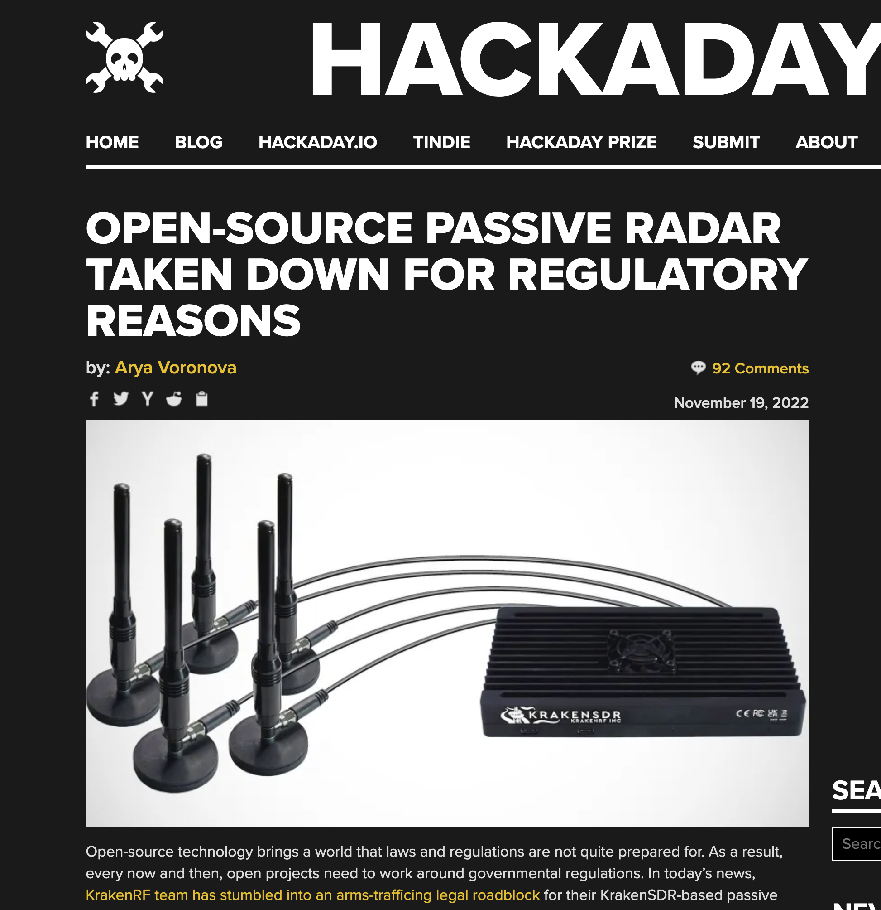

Why Do We Care?
Because our community has already been negatively affected.

Slide 18
Knowledge is Power
SAR is controlled under ITAR or EAR depending on the technical specifications.
Canada and the UK have similar controls on SAR.
Both ITAR and EAR include exemptions for “public domain” or “published” work, respectively.
Physical distribution of all technical information covers “public domain” exemption in ITAR - Internet is not enough without additional (achievable) work.
Physical distribution of all technical information covers “published” exemption in EAR if it’s freely available to the general public, such as from a library, conference, trade show, or Internet.

Slide 19
If You Publish It Must be Free
Take advantage of the public domain carve-outs in ITAR and EAR by publishing your technical information as Open Source according to the definitions in the regulations.
If you manufacture an article, you must register with the Directorate of Defense Trade Controls, even if you do not export, and even if you only make one article.
There is an exemption here too!
“Persons who engage in the fabrication of articles solely for experimental or scientific purposes, including research and development.”

Slide 20
But What About the FCC?
Passive radar does not require the sensing station to make a transmission, therefore the regulatory situation is pretty good.
In the US, licensees in the amateur radio service are allowed to use pulse modulation. This includes radar pulses.
Nothing in Part 97 prohibits radar.
FCC allows pulse transmissions on the 33 cm band (900 MHz) and above.

Slide 21
But What About the FCC?
Unlicensed bands are an option.
MIT coffee can design uses 2.4 GHz.

Slide 22
Don’t Be Afraid – Be Open
Quality Open Source publishing qualifies for the public domain carve outs.
Manufacturing something solely for experimental or scientific purposes, including research and development, qualifies for the manufacturing exemption.
Take control of the airwaves with less fear.

Slide 23
Open Research Institute
Non-profit dedicated to open source digital radio.
You and your project are welcome.
https://openresearch.institute/getting-started

Slide 24

Thank you to Zero and RF Village!
ORI Newsletter Sign Up

